Slide 1
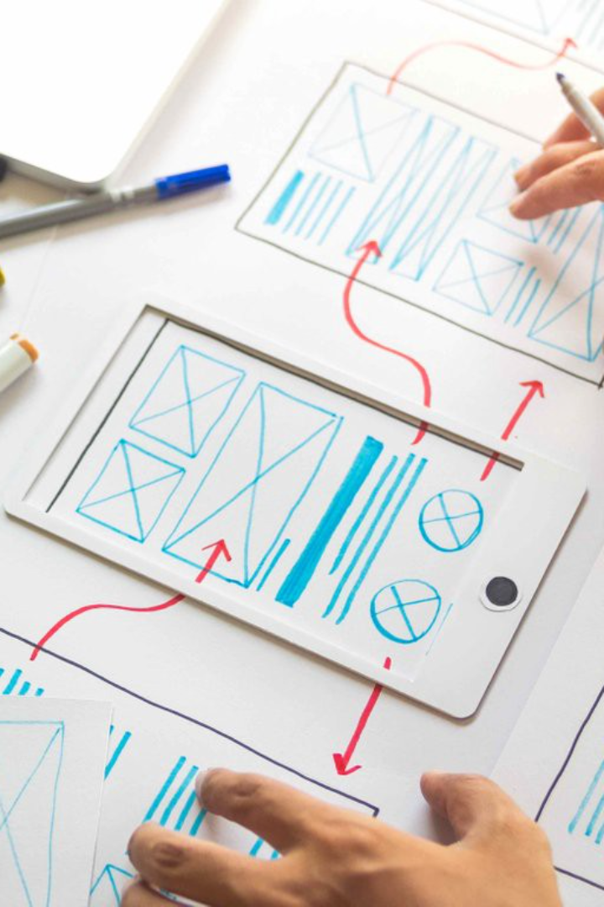
UXPin
UXPin is a powerful design and prototyping tool that enables you to create exceptional user experiences. This presentation will explore its features, benefits, use cases, and integration options.
Jaydeep Lokhande

Slide 2

Introduction
UXPin is a leading design and prototyping tool used by designers worldwide. Discover how it empowers designers to create intuitive and visually appealing user interfaces.

Slide 3

Features
Responsive Design
Interactive Prototyping
Collaboration
Create designs that adapt to different devices and screen sizes, ensuring optimal user experiences.
Collaborate seamlessly with team members and stakeholders, ensuring effective communication and alignment.
Bring your designs to life with interactive elements and simulate user interactions for realistic user testing.

Slide 4

Benefits
1
Efficiency
2
Consistency
3
Usability Testing
Save time and effort by streamlining your design and prototyping workflows in one all-inclusive tool.
Maintain a consistent design language and ensure visual harmony throughout your projects.
Create realistic prototypes to conduct user testing and gather valuable insights for iterative design improvements.

Slide 5
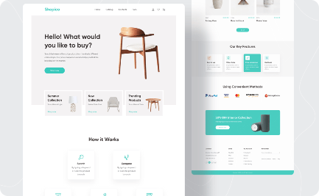
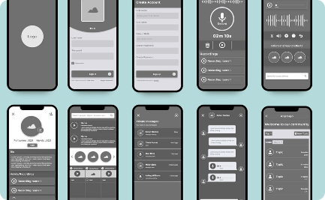
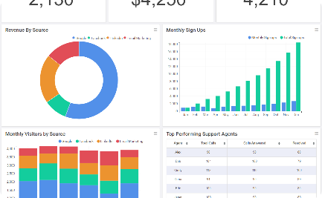
Use Cases
E-Commerce Websites
Mobile App Design
Analytics Dashboards
Showcasing how UXPin can be used to design seamless and engaging online shopping experiences.
Exploring the process of creating user-friendly mobile app interfaces and intuitive interactions.
Demonstrating how UXPin can be utilized to design data visualizations and interactive analytics dashboards.

Slide 6
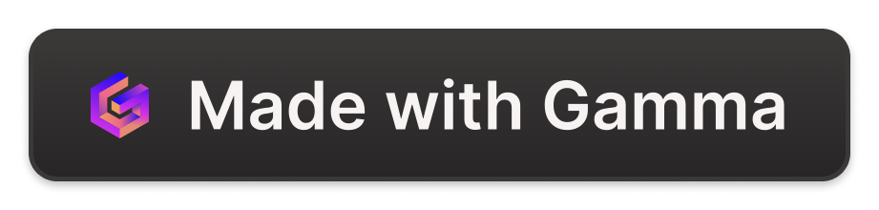
Tips and Tricks
Component Libraries
Keyboard Shortcuts
Annotations
Optimize your workflow with various keyboard shortcuts to speed up common design and prototyping tasks.
Add annotations to your designs to provide context and guidance for developers and stakeholders.
Create reusable design components and maintain design consistency across multiple projects.

Slide 7

Integration and Collaboration
UXPin integrates with Sketch and Figma for efficient collaboration. Experience real-time collaboration and version control.

Slide 8

Conclusion
UXPin empowers designers to unleash their creativity and create remarkable user experiences. Explore its features, benefits, use cases, and integration options today to revolutionize your design process. Now, let's open the floor for questions and discussion.

Slide 9


Slide 10
THANK YOU

